Slide 1
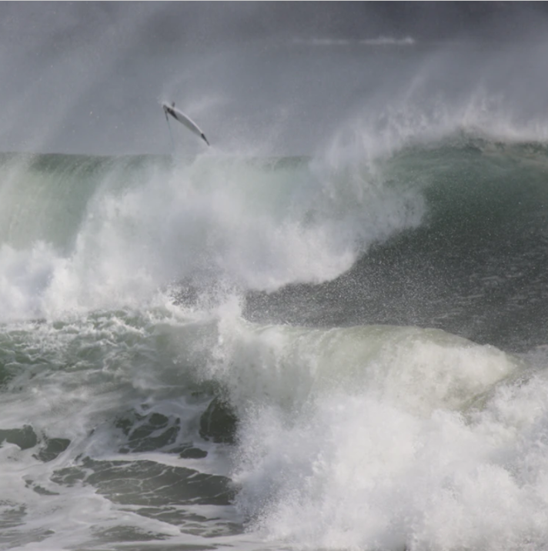
EFFECTUATION
Experience the world through an adaptability lens
Page 21

Slide 2



1
2
3
Notes:
Raise your hand.
I realize latest since COVID that most go “3”
That leads into the Adaptability Paradox

Slide 3


Saras D.
Sarasvathy,
PhD
Professor of enterpreneurship business strategy and ethics
Darden University
US
Teaches in Denmark,
India, South Africa
Notes:
14 Years of research, 120 studies, interviews with CEOs

Slide 4
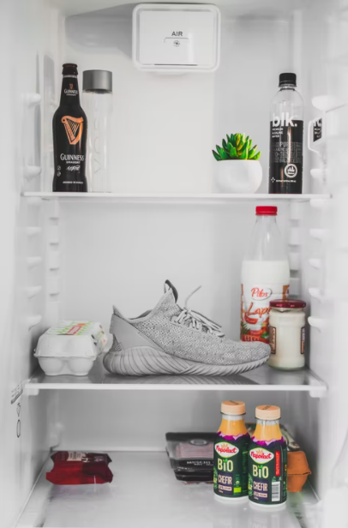
Effectuation
What do organizations in a highly turbulent context do to stay futurable?
Work with what is already under control to co-create the future
Notes:
There are no findings concerning deeds or strategies
But a common denomiator when it comes to attitudes
The dinner:
Causal logic dinner
It begins with a pre-set goal, a given menu and focuses on selecting between effective ways to prepare the effect (meal)
Effectal logic dinner
It begins with given means (ingredients and utensils) and focuses on preparing one of the many possible desirable effects (meals) with them

Slide 5
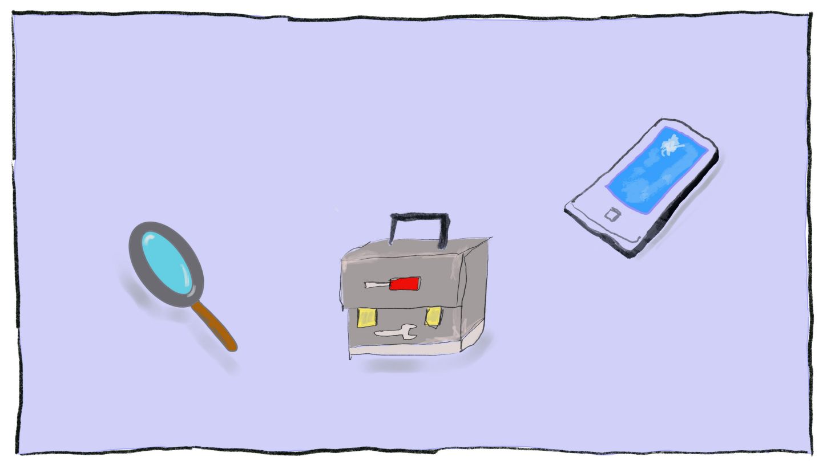
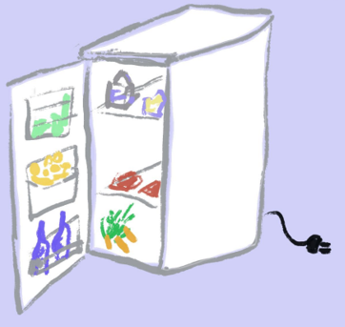

1. Means-Orientation
Notes:
Which means to I have at hand in my organization or as a founder/start-up?
Metaphor of the fridge. (or „bird in the hand“)
Identity (what do I like, what motivates me, which ideas or dreams do I have?
Competences: knowledge, experience, machines, finances, services
Contacts: whom do I know I may contact

Slide 6

Biontec Pfeiser
they like to heal people
can develop anti-cancer drugs
contacts to U.S. regulatory authorities and the Paul-Ehrlich Institute

Slide 7


Ice Hotel
They love hospitality
They have ice and cold
Founder Nils Bergkvist has good friends in the Tourism Branch of Scandinavia
Notes:
Sweden

Slide 8







1. Means-Orientation
instead of Goal-Orientation
Notes:
Conventional Innovation
Needs of future customers
New ideas for my products of services of tomorrow
Or new customers for these products
What do I need to generate these ideas?

Slide 9

1. Means-Orientation
instead of Goal-Orientation
Notes:
Many Ideas coming from my means
THEN find target customer groups which have needs which may be met by these ideas/services

Slide 10

2. „Use“ mistakes and surprises
Causal approach
Surprises = problems
Try to reach the goal anyway
Effectuation-approach
Surprises = chances
Innovate adapting / changing your goals and targets
Notes:
Surprising changes or circumstances
Disruptive changes on the market
Reorganization
Change of the investor or boss
When life gives you lemons, make lemonade

Slide 11

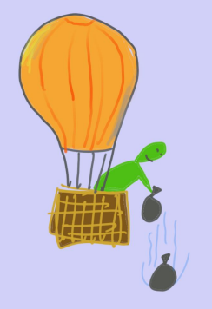
3. Affordable Loss
How much am I willing to lose
for this innovation?
financially
psychologically
socially
Notes:
How much can I bear? Invest, what you can afford to lose
That protects me from loosing it all in case of failure
Should I fail, I fail fast(er) and without unbearable financial or emotional pain.
As an employee or middle manager: how much innovation may I drive without risking my position?

Slide 12
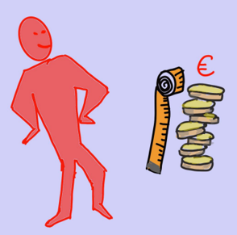
3. Affordable Loss instead of ROI
Causal innovation approach
Calculate the possible profit of each idea
Choose the idea with the highest ROI

Slide 13

4. Partnerships & Alliances
Build a network of self-selected stakeholders
With those who are willing to invest into the new idea and to co-shape it
Partners mediate the common future
Notes:
Do not keep the idea in secret! But share it with many others
Partners bring along their own means and ideas about new goals of the innovation
-> go back to „what can we do with what we have“
Be prepared to accept that the final product or service will look different than you expected before

Slide 14


5. Focus on activities you can control
if we can control the future, we don’t need to predict it!
The entrepreneur…
prefers action to analysis (is it the source of learning and transformation)
focuses on the controllable aspects of an unpredictable future
Page 29
Notes:
PILOT IN THE PLANE PRINCIPLE

Slide 15







Effectuation Principles
Means Orientation
Instead of goal orientation
Affordable loss
Instead of ROI
„Use“ mistakes & surprises
Instead of avoiding them
Partnerships & Alliances
Instead of competence
Shape the future
Instead of reacting
to trends
Page 30
Notes:
The more room these 4 principles gain, the less stress individuals and the organization suffer
This pays into the resilience of the organization
Shall we switch from conventional innovation to Effectuation in every case?
NO!

Slide 16
Effectuation
Is a learnable routine to deal with the unexpected.
It lowers the forecast effort,
Avoids stressful reactions to reach fix goals
Notes:
The best way to foresee the future is to creat it (P.Drucker)
Focus only on that you can influence
Thanks for your attention

Slide 17
Effectuation hands on guide
Use the circumstance as chance
Check the available means
What can I DO?
How much is the innovation worth for me, how much can I risk?
Share your idea
Build partnerships and coalitions
Based on these new means, complement your ideas and goals and execute the idea
1
2
7
3
5
6
4

Slide 18
How entrepreneurs build ventures: causal logic
Come up with a brilliant idea
Show that there is a large market for it
Write a winning business plan
Raise money
Build and grow the venture
Go public or sell
Live in the Bahamas

Slide 19
Causation: bringing a product to market
The STP process: Segmentation - Targeting - Positioning
You assume the market is pre-existent
Analyze long run opportunities in the market
Research and select target markets
  Develop profiles of resulting segments
  Evaluate the attractiveness of each segment
  Select the target segment(s)
  Identify positioning concepts for each target segment
  Select, develop and communicate the chosen positioning concepts
  Design marketing strategies
Plan Marketing programs
Organize, implement and control marketing effort

Slide 20
What does the equation look like?
Starting point = YOU The start of an entrepreneurial project is not the idea, it’s you
YOU + trigger = IDEA Starting ideas are often very simple and highly personal
Idea + Action = OPPORTUNITY Act more, analyze less
Opportunity + Stakeholders commitment = Viable project
Each new stakeholder brings new ressources and new constraints

Slide 21
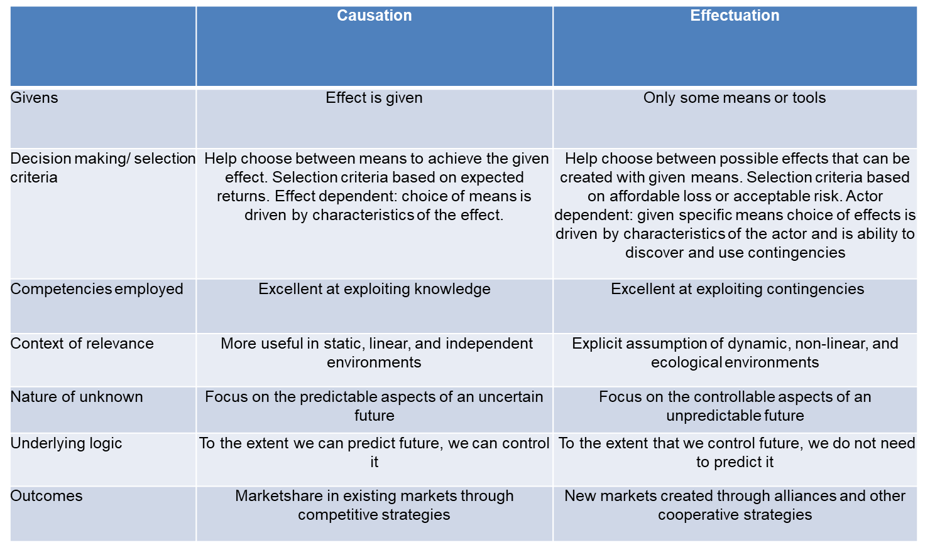
causation vs effectaution

Slide 22
Effectuation Tools for Leaders
Tool 1: Trigger Impulse
Tool 2: Affective Accounting
Tool 3: My / our individual resources
Tool 4: My / our social resources
Tool 5: Take advantage of mistakes and surprises
Tool 6: Affordable Loss
Tool 7: Partner Interaction Plan
Tool 8: Partnerships and alliances

